Slide 1
2021
Sunshine Law & Public Records
Presented by:
Margaret M. Sidman, Managing Deputy & Deputy of Legislative Affairs
Paige H. Johnston, Chief of Legislative Affairs
Office of General Counsel

Slide 2
Section 286.011, Florida Statutes A Public Meeting is:
Meeting/Conversation/Discussion
Two or more Council or Board Members of the same entity
Where a matter that is likely or foreseeably to be considered by that
entity is discussed

Slide 3
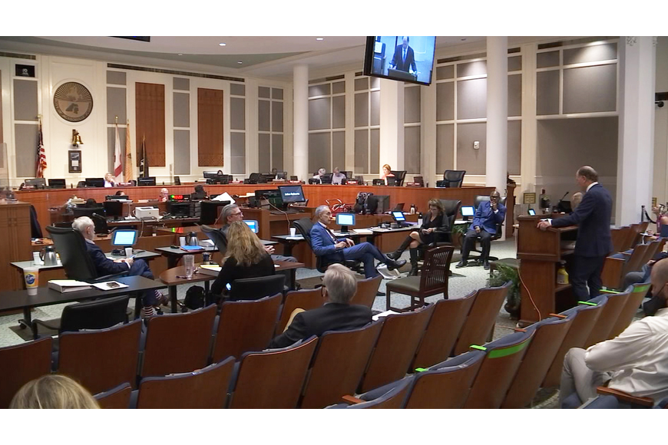
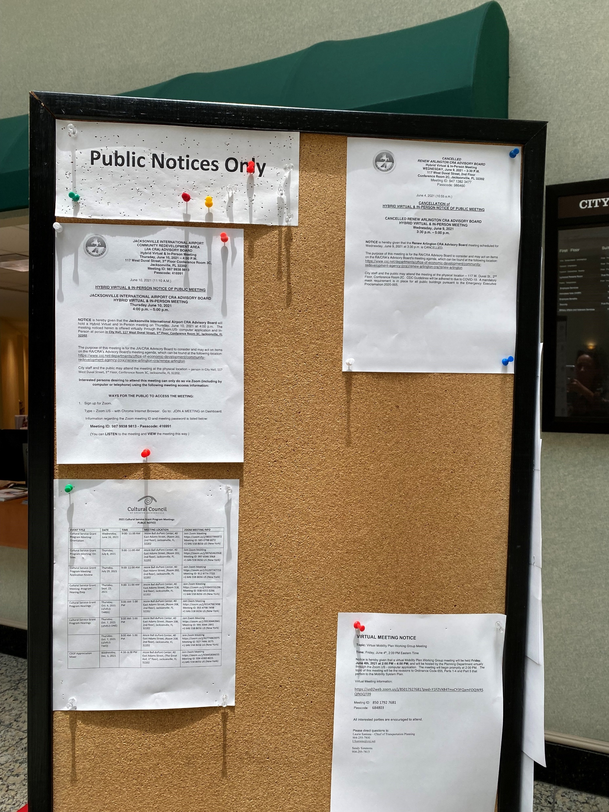
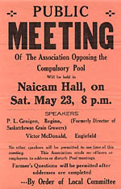
Section 286.011, Florida Statutes The Law Requires:
These Meetings are to be open
and accessible to the public
Reasonable advance notice of
the meeting
Written minutes of the meeting

Slide 4
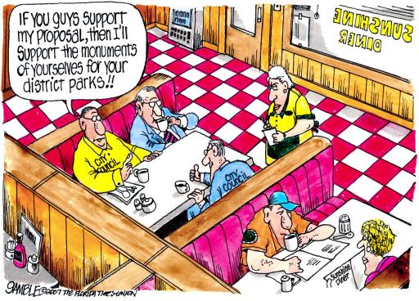

Slide 5
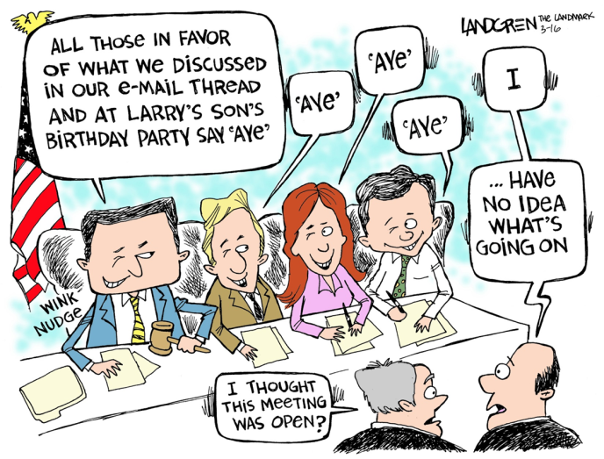

Slide 7
Question
Council Member A asks her ECA to send a draft resolution to Council Member B, who knows the honoree well, before filing to see if Council Member B wants to be a co-introducer. The ECA forwards the resolution by e-mail with this message “Council Member A will be filing this resolution next week and wanted me to send it to you to see if you want to add your name.”
Council Member B responds to the ECA: “I have added information about Ms. X that I learned while working with her. Please make these changes and add my name as co-introducer.”
ECA makes the changes to the resolution, informs Council Member A of those changes, adds Council Member B’s name to the resolution and submits to OGC for filing. Is this a Sunshine Law violation?
Yes
No
Maybe

Slide 8
What is a Public Record?
Florida Statutes §119.011(12) defines “public records” as:
All documents, papers, letters, maps, books, tapes, photographs, films, sound recordings, data processing software, or other material, regardless of the physical form, characteristics, or means of transmission, made or received pursuant to law or ordinance or in connection with the transaction of official business by any agency.

Slide 9
Retention Schedule
Public Records Subject to Retention Schedules created by the Division of Library and Information Services of the Department of State:
257.36 Records and information management.—
* * *
(6) A public record may be destroyed or otherwise disposed of only in accordance with retention schedules established by the division. The division shall adopt reasonable rules not inconsistent with this chapter which shall be binding on all agencies relating to the destruction and disposition of records. Such rules shall provide, but not be limited to:
(a) Procedures for complying and submitting to the division records-retention schedules.
(b) Procedures for the physical destruction or other disposal of records.
(c) Standards for the reproduction of records for security or with a view to the disposal of the original record.

Slide 10
Retention Schedule Continued
The Retention Schedule for each public record is not based upon the type of communication (e-mail, text, social media), but is determined based on their legal, fiscal, administrative and historical values, regardless of the form in which they reside or the method by which they are transmitted.
*See General Records Schedule GS1-SL for State and Local Government Agencies, Electronic Communications, available online at http://dos.myflorida.com/library-archives

Slide 11
Question
Council Member C is tech savvy and uses all of the latest apps and social media platforms, such as Twitter, Instagram, and Facebook and maintains a blog on his personal website to communicate with constituents.
Which of the following is true?
He can limit the people who join his accounts/pages to those who live in his district.
He does not have to maintain these accounts as public records because they are on private apps/platforms.
He has to maintain all accounts pursuant to the state retention schedule since the accounts are subject to public records law.
He can block other Council Members from his accounts/pages to avoid potential Sunshine Law violations

Slide 12
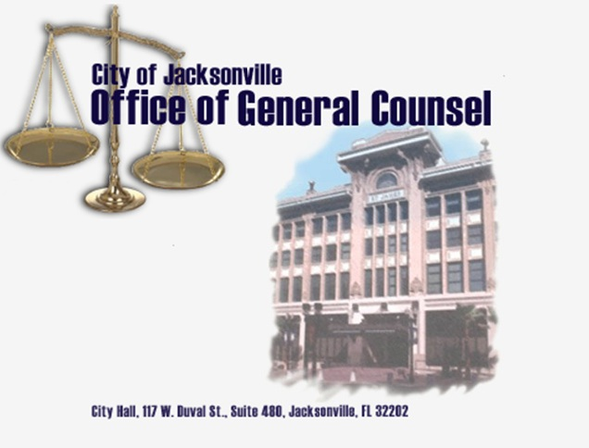
Thank You!

